Slide 1


Light Speed Cinemas

Slide 2
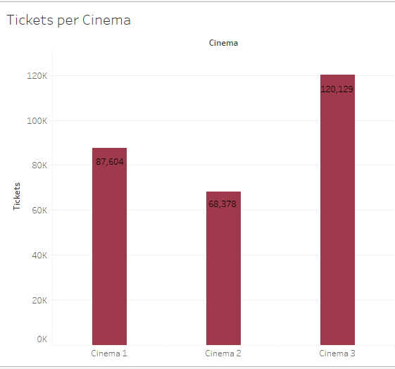
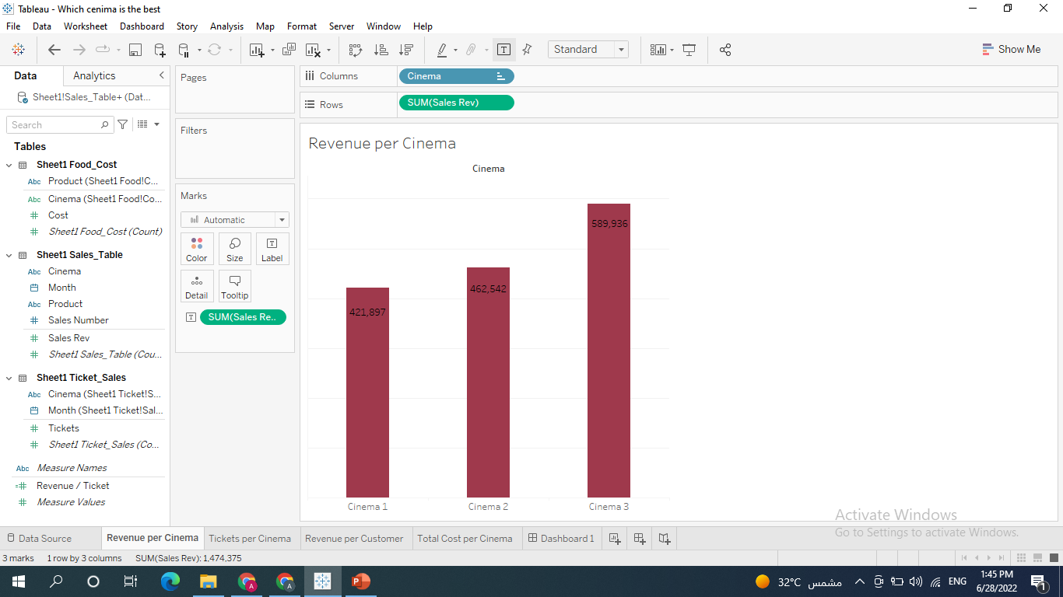
Which Cinema achieves the highest Revenue?

Slide 3
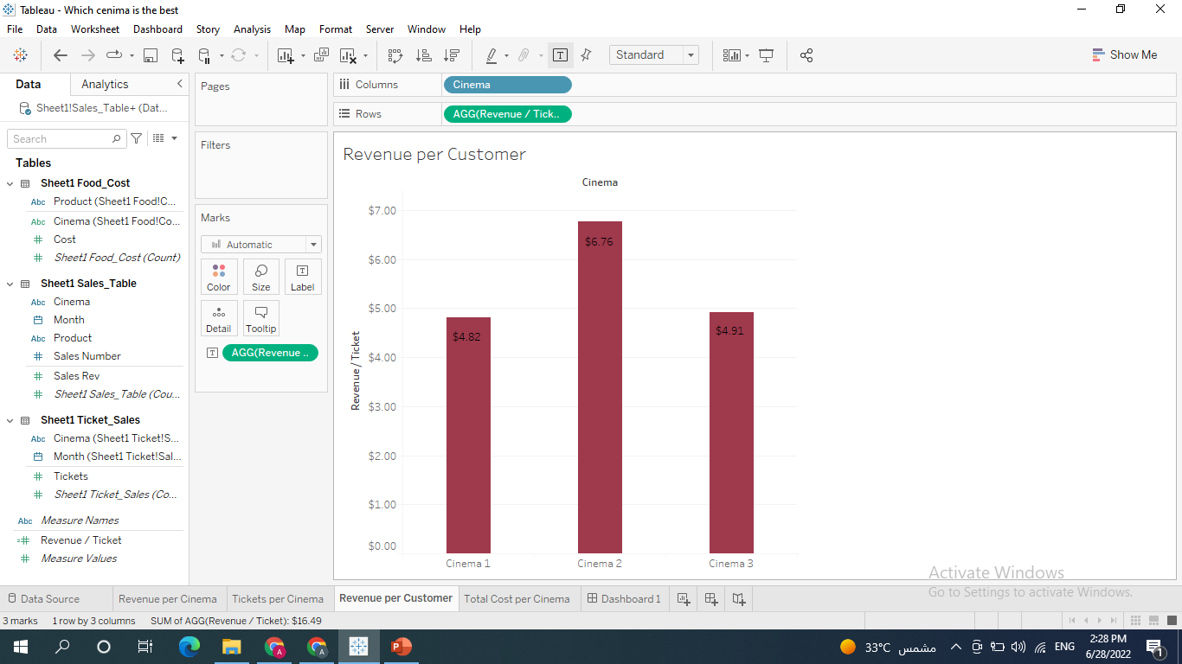
Cinema 2 is the best
Cinema 2 generates the most revenue per customer at the concession stand.

Slide 4
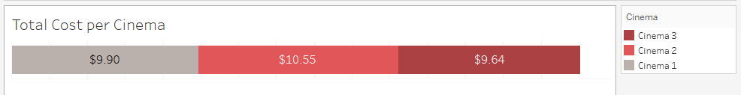
Why is ‘Cinema 2’ the best
‘Cinema 2’ sells the products at the highest price.

